Slide 1


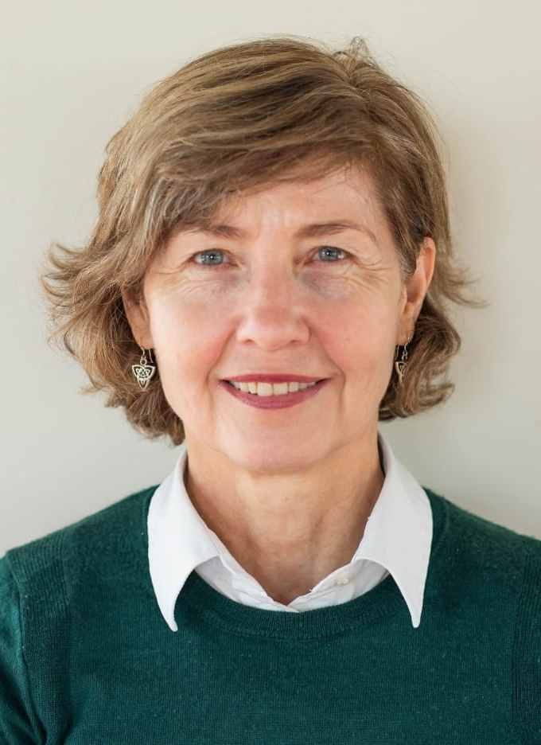





The Typing Workshop
Learn how to facilitate self-discovery in your clients
14 – 16 August 2026 & 5 – 6 September 2026 (28 hours)
Purpose and Objectives
The overall purpose of this Typing Workshop is to help clients discover what motivates patterns of thinking, feeling and behaving.
Type cannot be determined from external behaviours but only from a deeper understanding of focus of attention, underlying motivations and lived experience. From neuroscience we know that learning through experience rather than being given an insight is hugely impactful in creating new neural pathways that transform rather than merely inform.
Our training methods will include short panels, practice sessions on type interviewing, panel leadership and self-observation, type group exercises, typing process demonstrations, brief lectures, script development and practice interviews with volunteers from the community.
Suzette Fischer is the associated trainer of The Narrative Enneagram (TNE) in South Africa. She has journeyed, studied and practices the Enneagram since 2000.
She is spiritual director and has taught the Enneagram in South Africa, Malawi and Namibia since 2003.
www.enneagramsa.co.za
The key objectives are to:
1
2
3
To create a deep and
compassionate
understanding of –
and respect for –the
complexity of type and
the keys to differentiating
one type from another.
To learn how to conduct
typing interviews using
The Narrative Enneagram
inquiry method.
To learn how to lead a
panel in the way of
The Narrative Enneagram.
DATES:
14 – 16 August & 5 – 6 September 2026
Standard Rate: R12000.00
Lower Rate: R9000.00
Supporter Rate: R15000.00
International Rate: €820.00, $885.00
DIVERSITY SCHOLARSHIPS are available through the EPTP Scholarship Fund.
For details or further information regarding financial limitation, contact Suzette on
WhatsApp: +27 79 6972558 or suzette@enneagramsa.co.za

